Slide 1

Java - JDBC
Kimberly Preece

Slide 2
Introduction
For this project, the focus was around building an OOP (Object Oriented Program) that utilizes the following practices:
Compose and Analyze problem requirements.
Design and test solution.
Specific problem resolution with console input/output.
GUI basic and advanced controls.
File and Database External Source processing.
Program Debugging.

Slide 3

Setting the Foundation of our Project
To begin building our program we need to first lay the foundation.
In the foundation we will create a wireframe and UML diagram to understand the requirements of our project.

Slide 4

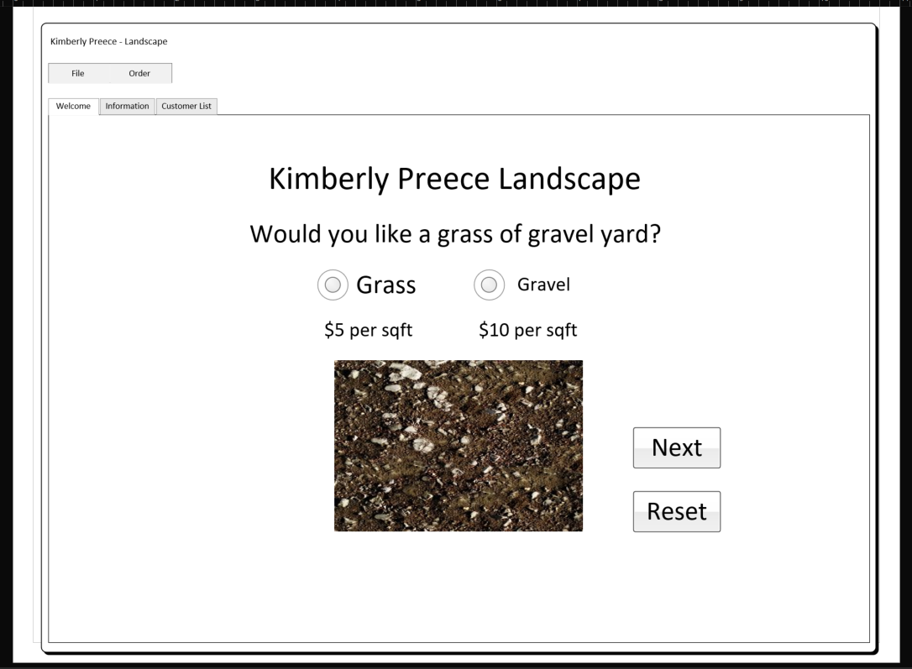
GUI build from Wireframe Diagram: Part I
The first step is to lay the foundation of our design.
To do this we have created a layout of our GUI design in Visio Wireframe.
This design displays what our first tab “Welcome” should look like.
This tab will be responsible for allowing the user to choose between a gravel or grass yard.

Slide 5
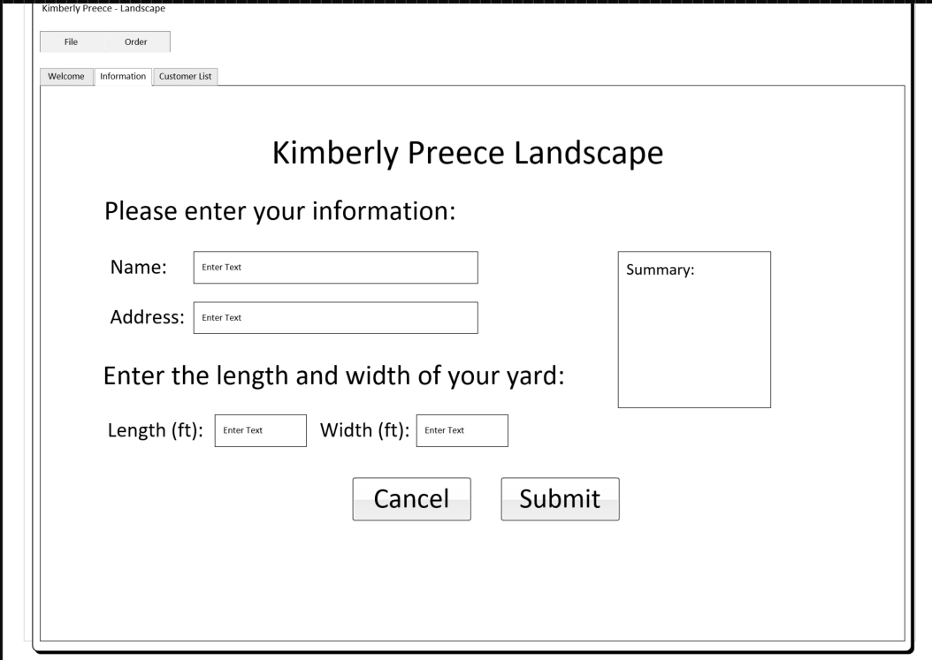
GUI build from Wireframe Diagram: Part II
The second step is to create a layout of our second tab “Information”.
This tab is responsible for letting the customer input their information and create an order for landscaping.
The tab will give the customer a Summary of their order and details in a Text Area located on the right, before they submit their order.
It will also give the customer a chance to cancel the information they have chosen to input.

Slide 6
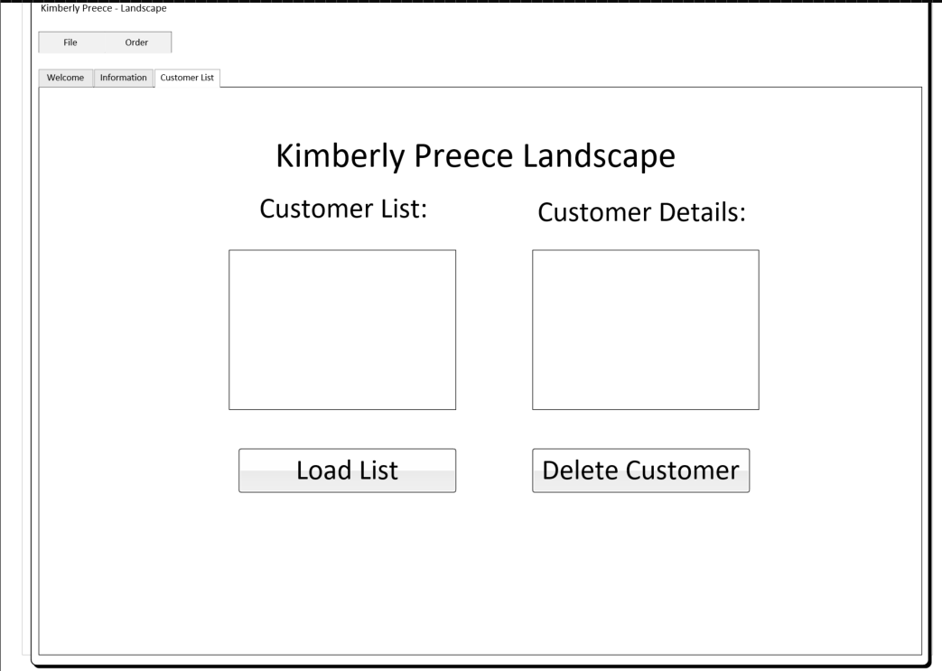
GUI build from Wireframe Diagram: Part III
The third step is to add our third tab “Customer List”.
This tab will be responsible for displaying customer information and details.
It will also be responsible for deleting customer orders.

Slide 7
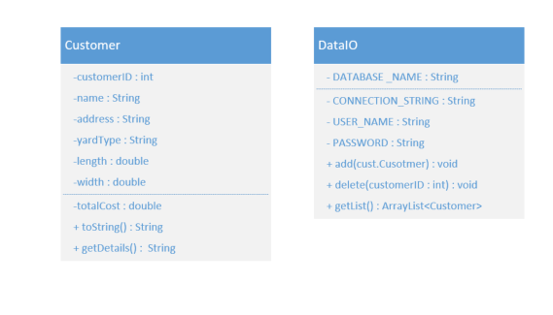
GUI build from Wireframe Diagram: Part IV
The final step in creating the layout of our project is to create a UML Diagram.
This diagram details what we will need for our project.
What information we may need from the customer.
What information we need to read, write, and extract from our database.

Slide 8
Building the GUI in Apache Netbeans
Now that we have laid the foundation of our program, it is time to begin building.
In this section we focus on creating the GUI Jframes and adding the necessary label, text, buttons, and text areas.
We also get our code ready to intake customer input and display customer information.

Slide 9
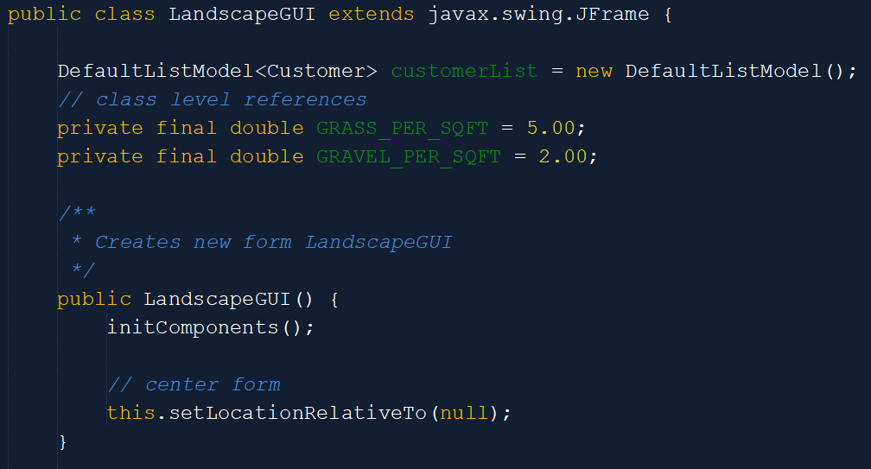
GUI Input and Output: Part I
Let’s start by creating the Landscaping class.
This class will create our DefaultListModel based on our Customer components
Set the square foot cost for grass and gravel
Set the location of our GUI frame
Call the components to action

Slide 10
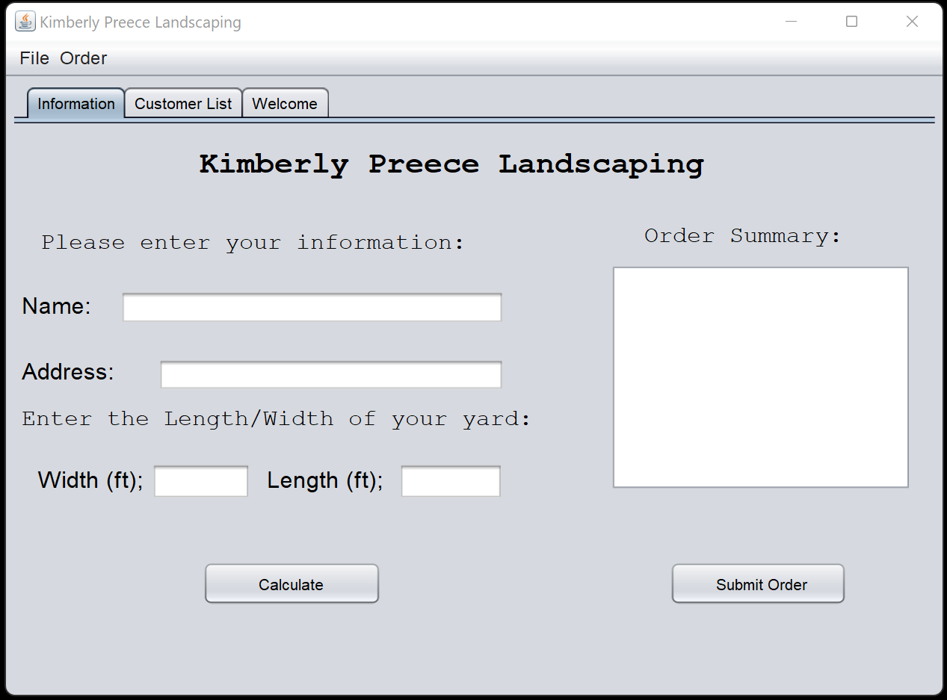
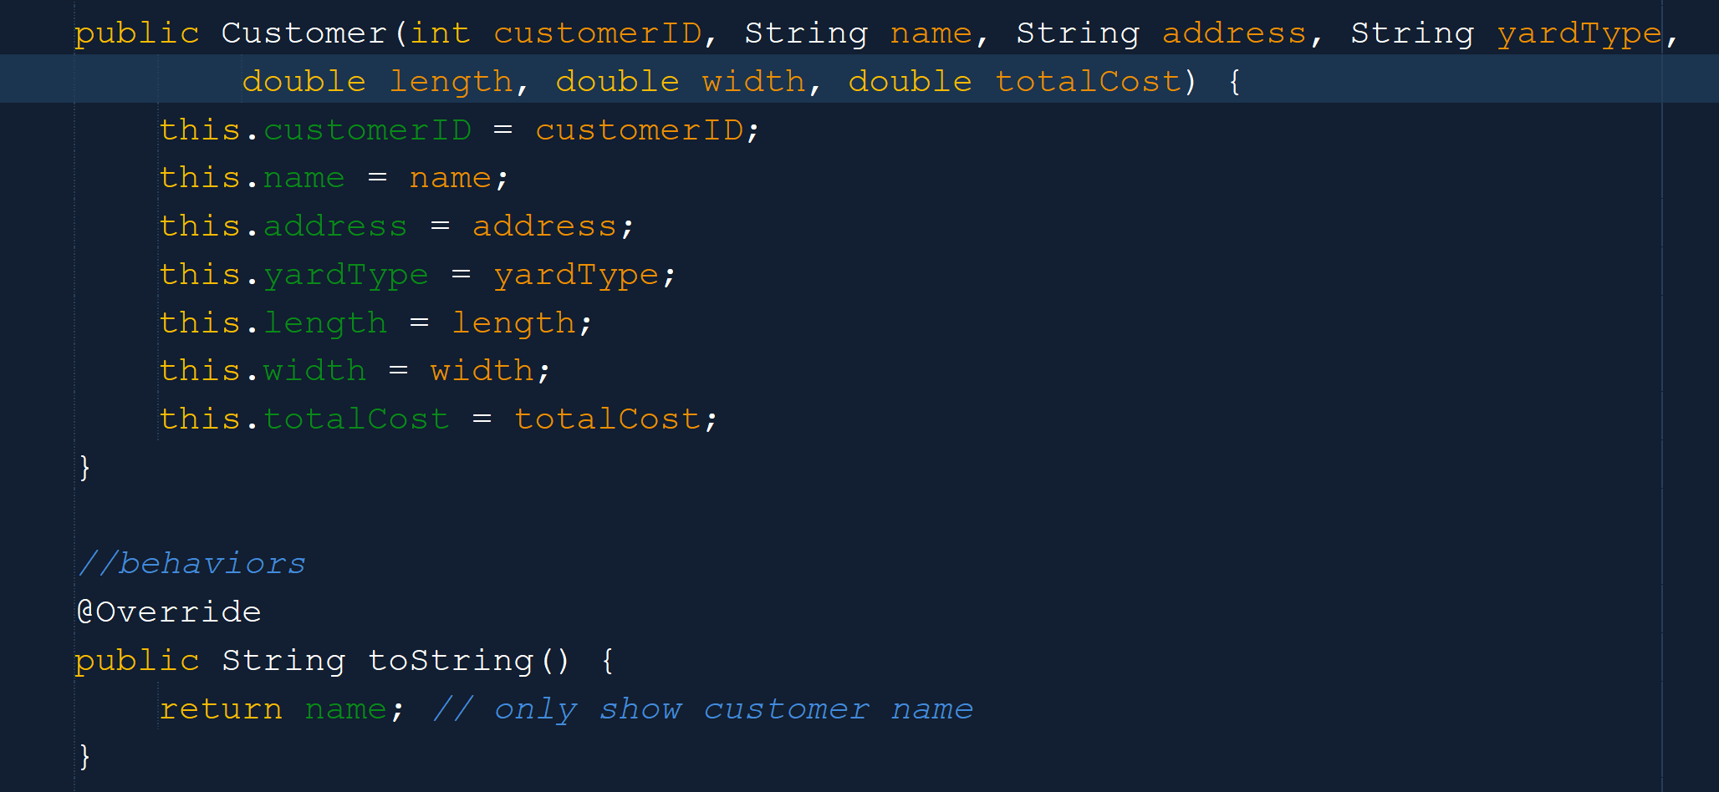
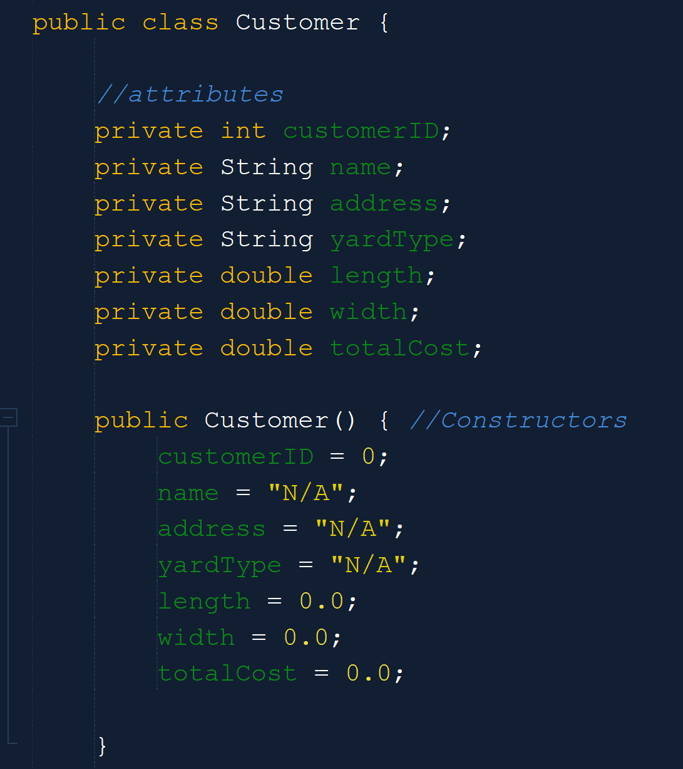
GUI Input and Output: Part II
This Information GUI tab will be responsible for the input of customer order information.
It will also be responsible for Displaying the summary of the customers input order.
To do this we have defined our attributes, behaviors, and set up the Customer components.

Slide 11
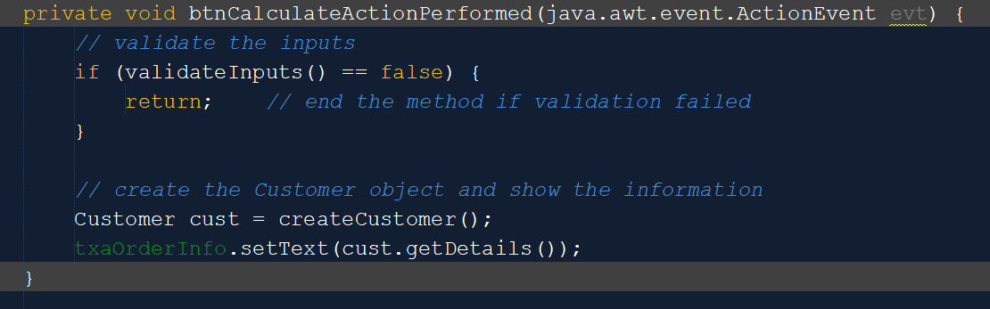
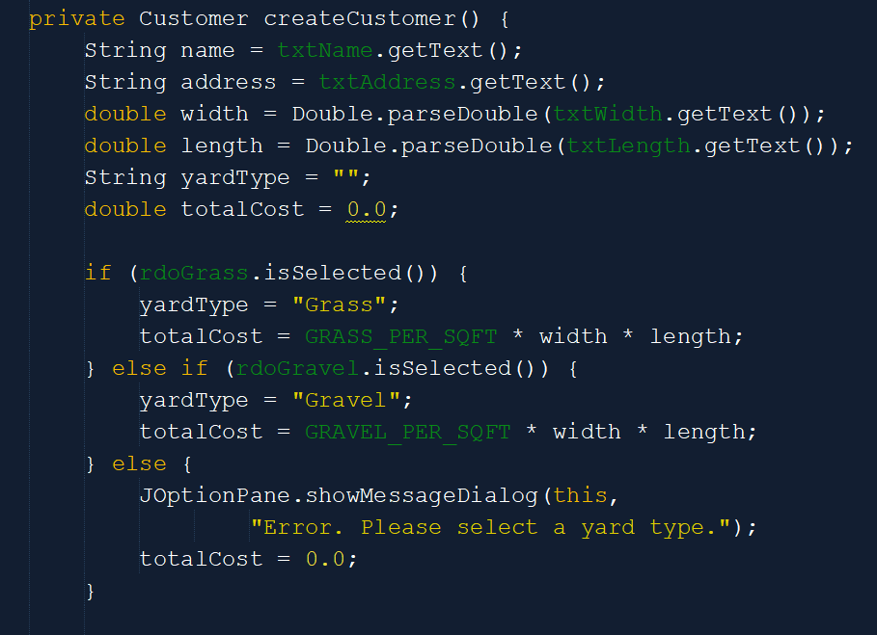
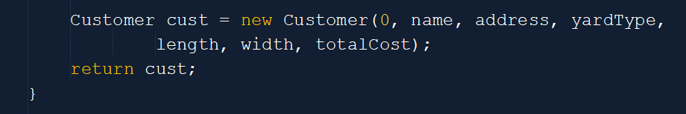
GUI Input and Output: Part III
When a customer creates an order, we need to be able to intake the information given and validate that information.
Here we take the input for width and length of their yard and calculate the cost based on the set price per square foot.
We also create a customer listing that gathers their name, address, width, and length of yard, to output to the “Summary” text area before submission.

Slide 12
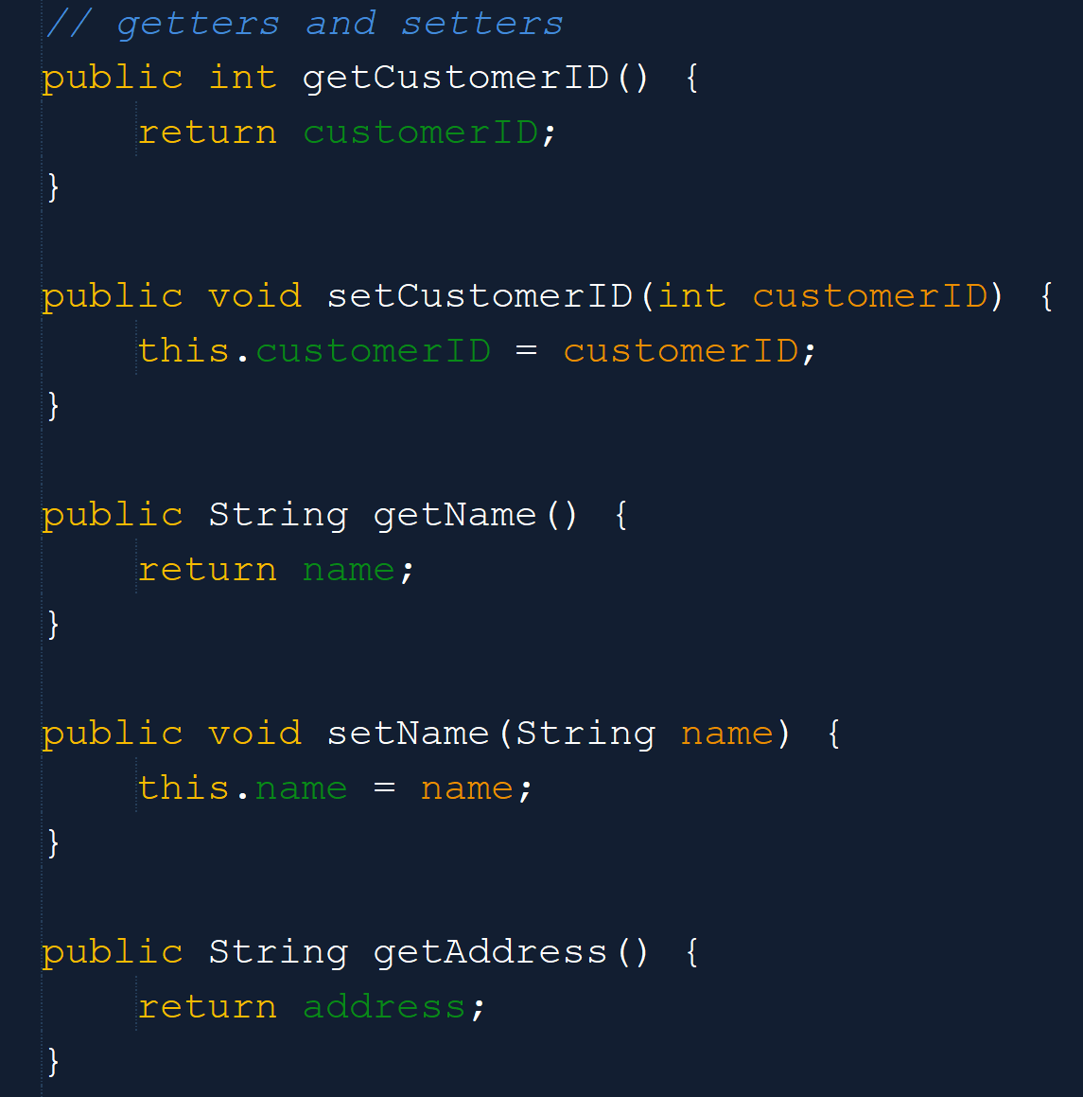
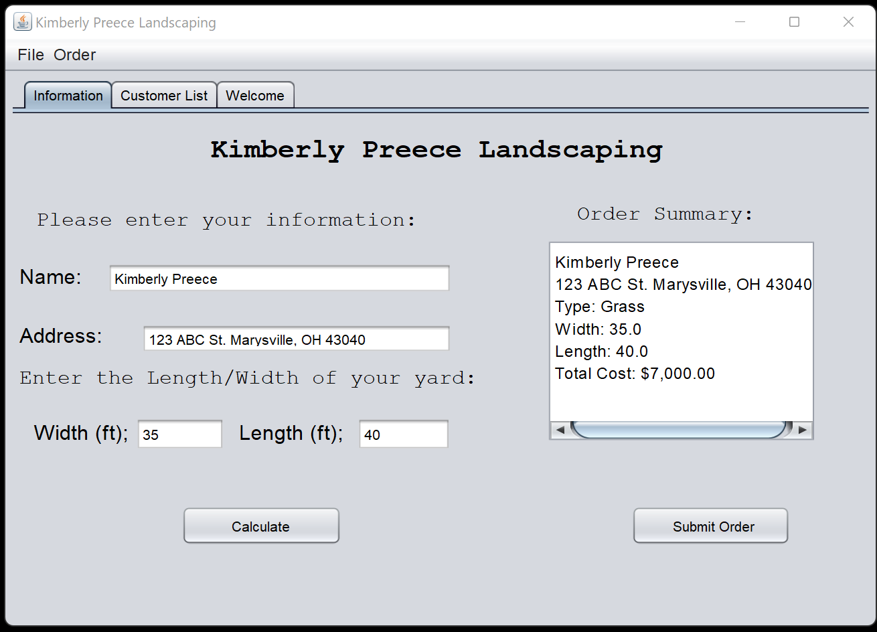
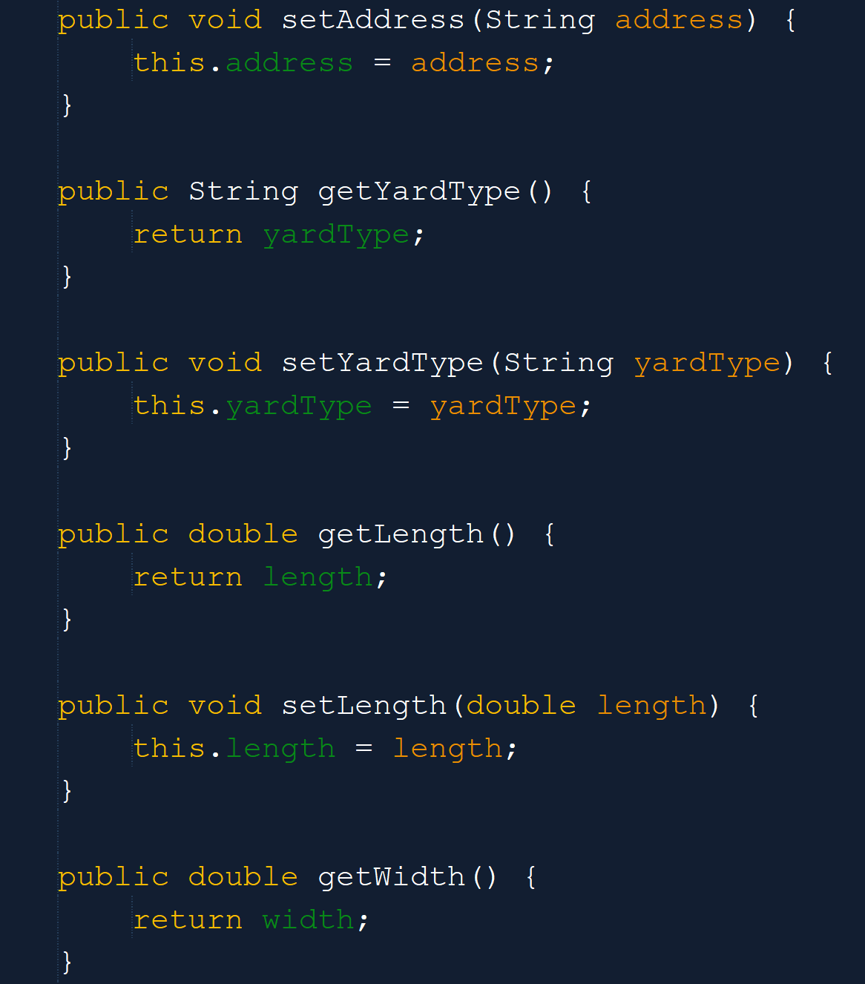
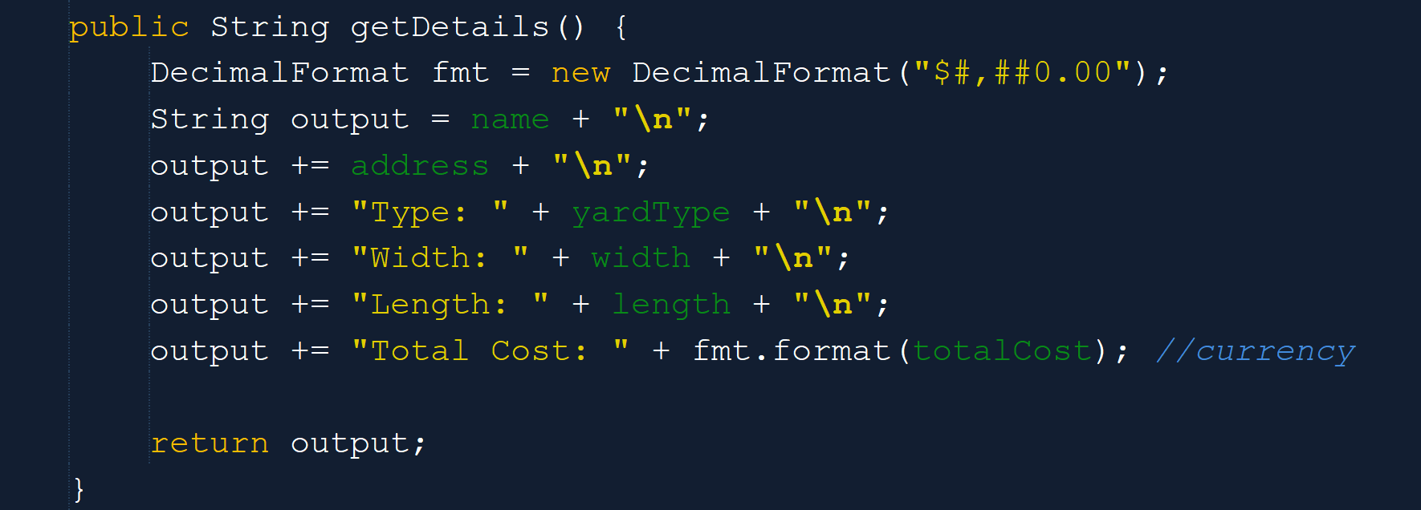
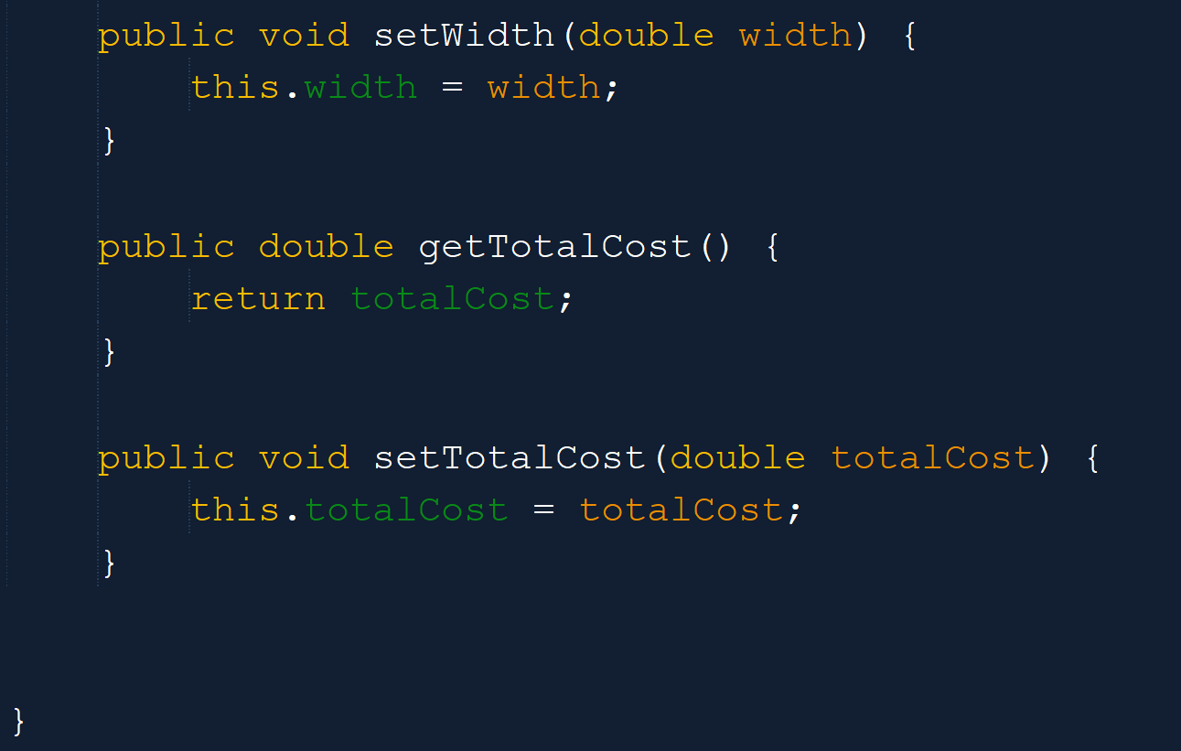
GUI Input and Output: Part IV
In this portion we have defined our getters and setters, collected the user input, and now we will display the collected information for the user before order submission.

Slide 13
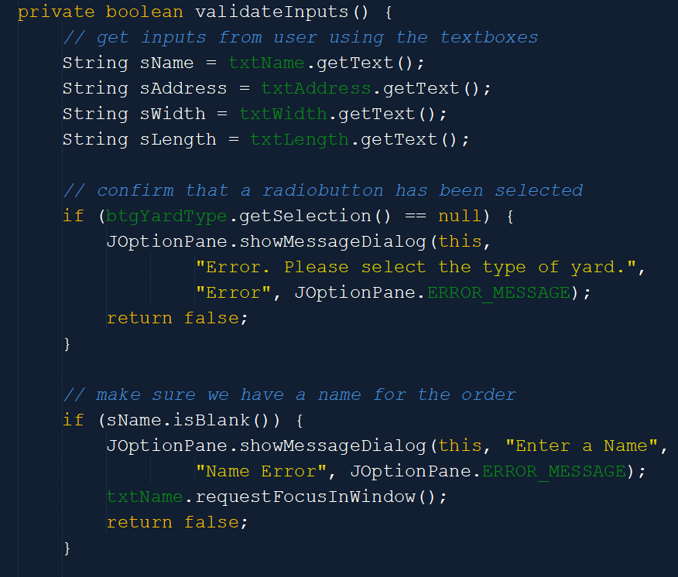
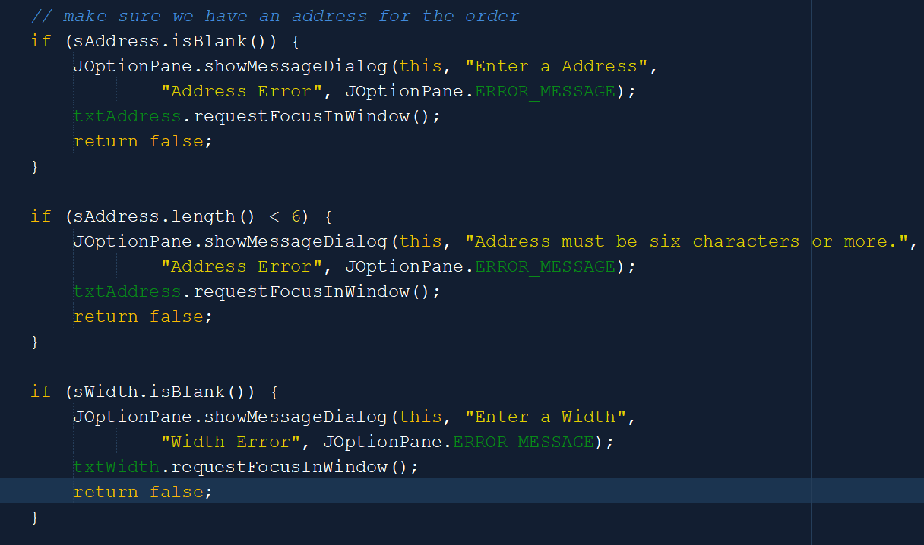
GUI Input and Output: Part V
After gathering all the information from users, we must validate that each field has met requirements.
To do this we have created a private Boolean named validateInput()
This will take the given input from each text field and assess the contents.

Slide 14
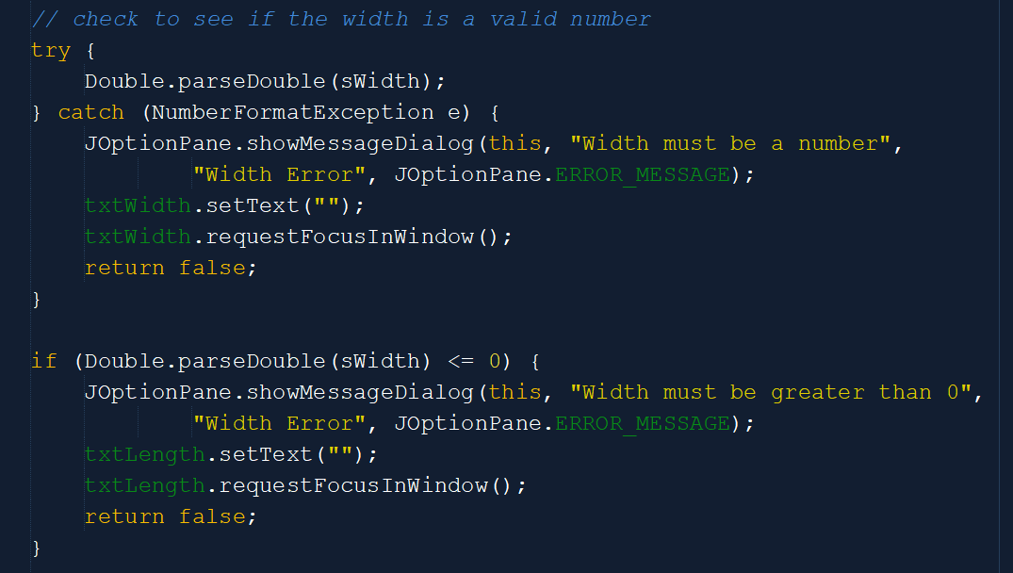
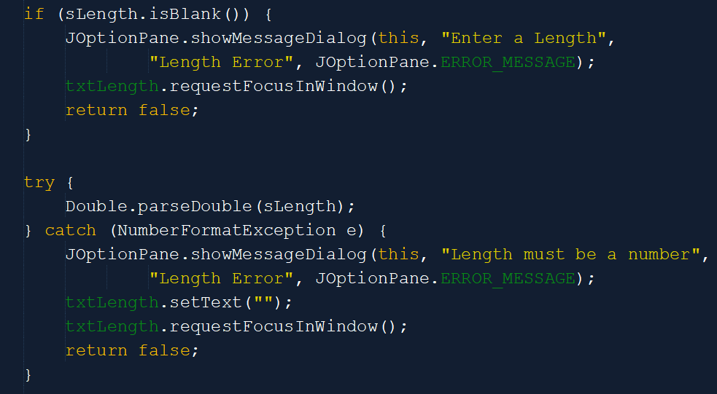
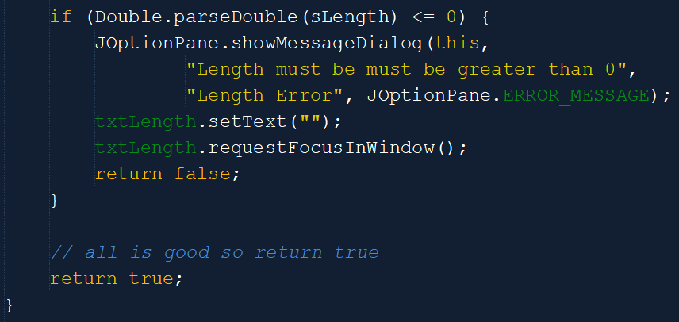
GUI Input and Output: Part V Cont.
Each assessment is set up with a try-catch.
These try-catches will throw errors when input is missing, or incorrect characters are entered.

Slide 15
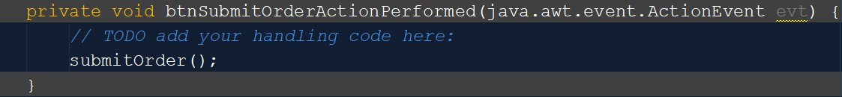
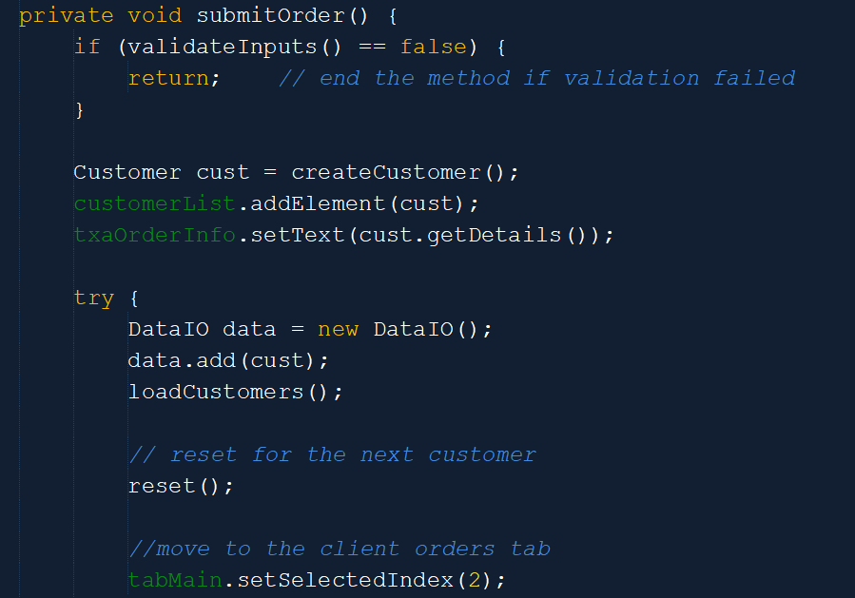
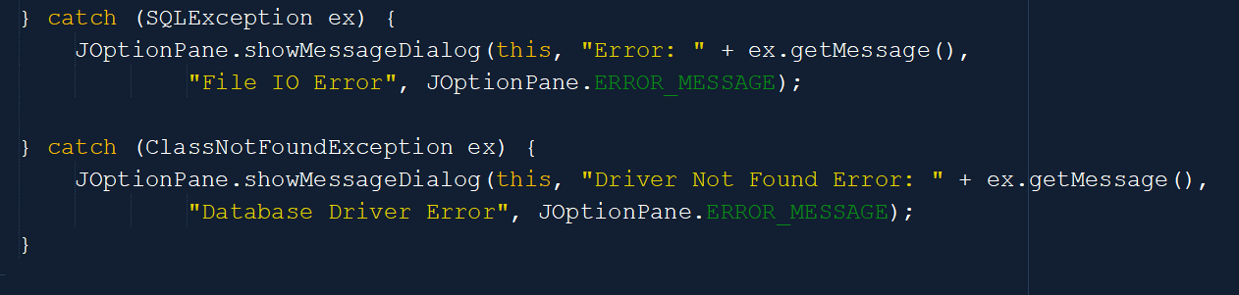
GUI Input and Output: Part VI
Once the customer is satisfied with their inputs, they will:
Select the “Submit Order” button.
This button will call a reusable function (submitOrder()).
This function will gather the information, test the information for validation or “true” input.
Throw an exception when errors occur.
And if no errors, clear the screen for the next order.

Slide 16
GUI Use of Advanced Controls
We have created the foundation and begun working on building the GUI.
Now it is time for us to implement more advanced methods and functions to correspond with our program.
The advances include radio buttons, menus, images, and icons.

Slide 17
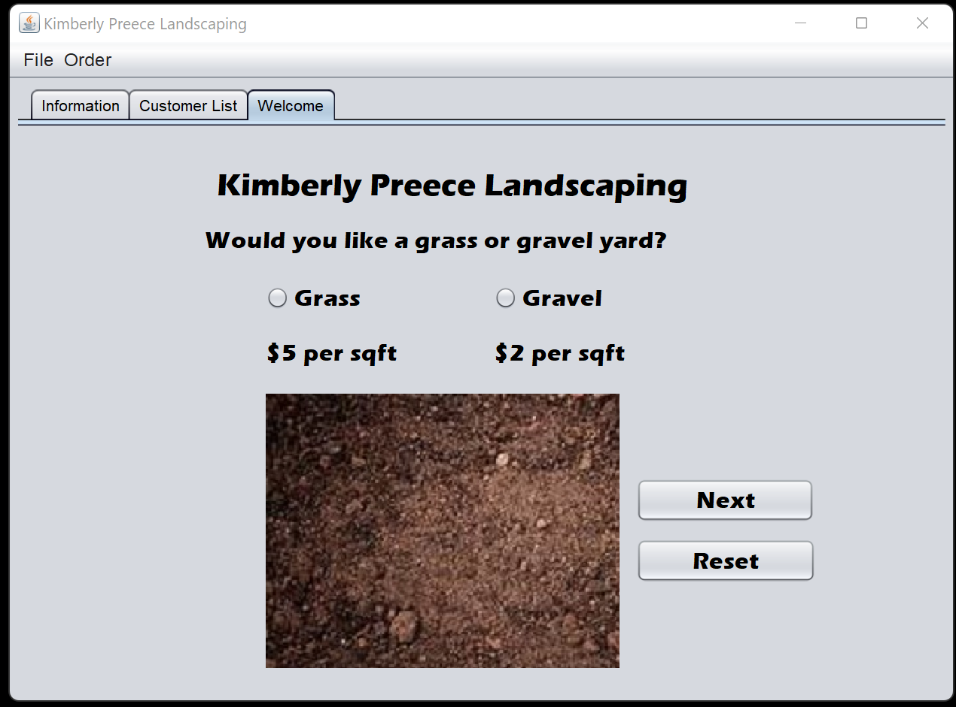
Advanced GUI Controls: Part I
The first step was to create a GUI Jframe consisting of the needed elements. These elements included:
Menu Bar – File, and Order
Submenus – File > Exit, Order > Submit Order > Reset
Tab Bar – Information, Customer List, and Welcome
The Company Title and Text Labels
The corresponding Radio Buttons, and general Buttons.
The Icons (images)

Slide 18
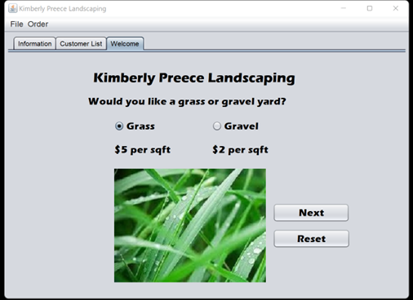
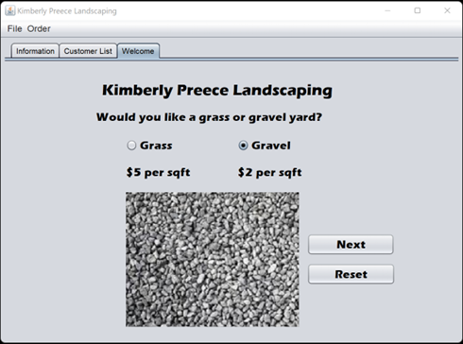
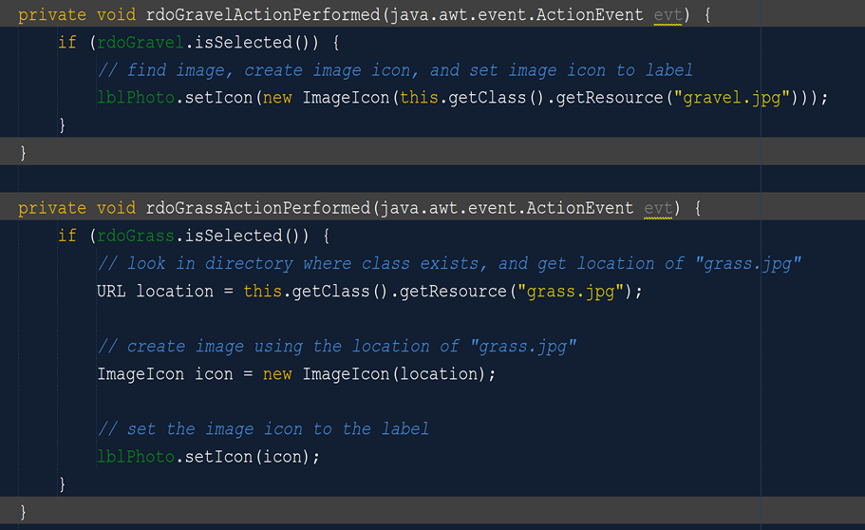
Advanced GUI Controls: Part II
The default image or icon is set to a dirt jpg.
If the Radio Button for grass is selected an ActionPerformed function is called to switch the Icon to a grass jpg.
If the gravel Radio Button is selected an ActionPerformed function is called to change the icon to a gravel jpg.

Slide 19
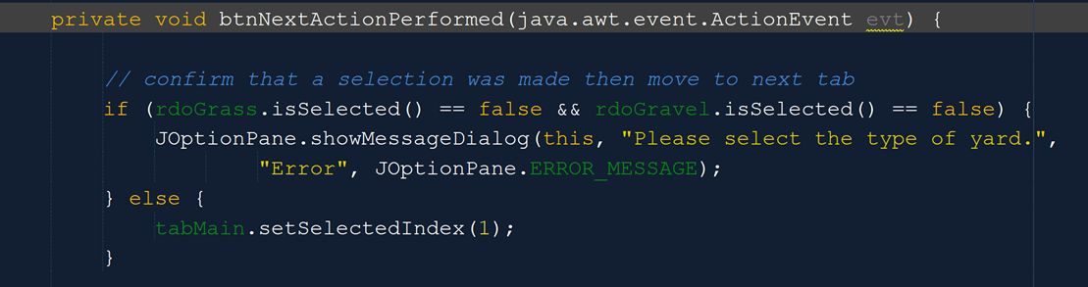
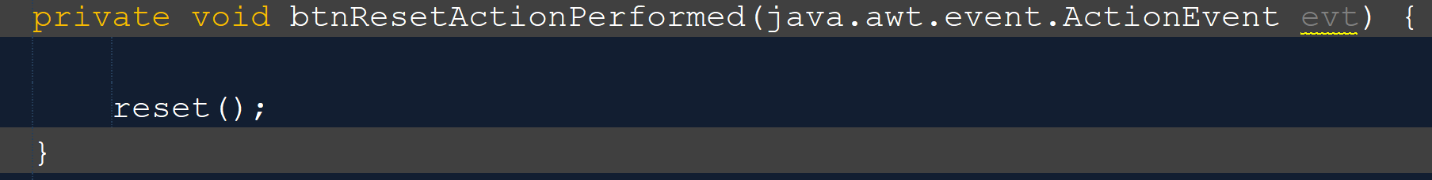
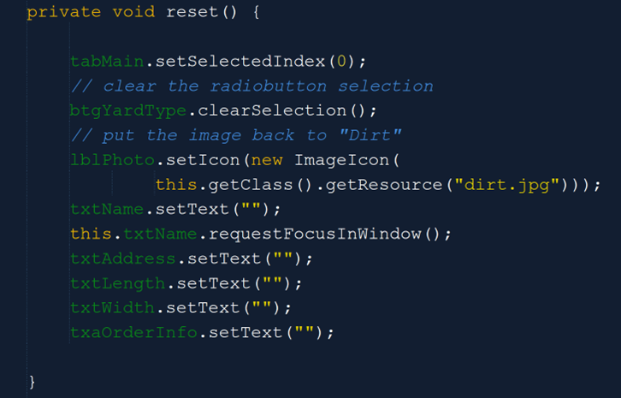
Advanced GUI Controls: Part III
The button requests “Next” and “Reset” were given ActionPerformed requests as well.
Each ActionPerformed was given a specific set of instructions to follow.
The Reset button simple calls a reusable function reset() that clears the screen and resets the data for new input.
We will also throw and error if a selection is not made before selecting the “Next” button.

Slide 20
ArrayLists, Tabs, and Jlist Controls
We have built the foundation and begun building the general program.
Now the fun part of taking all the user input and creating our customer lists.
We will do this by using ArrayLists and Jlists.

Slide 21
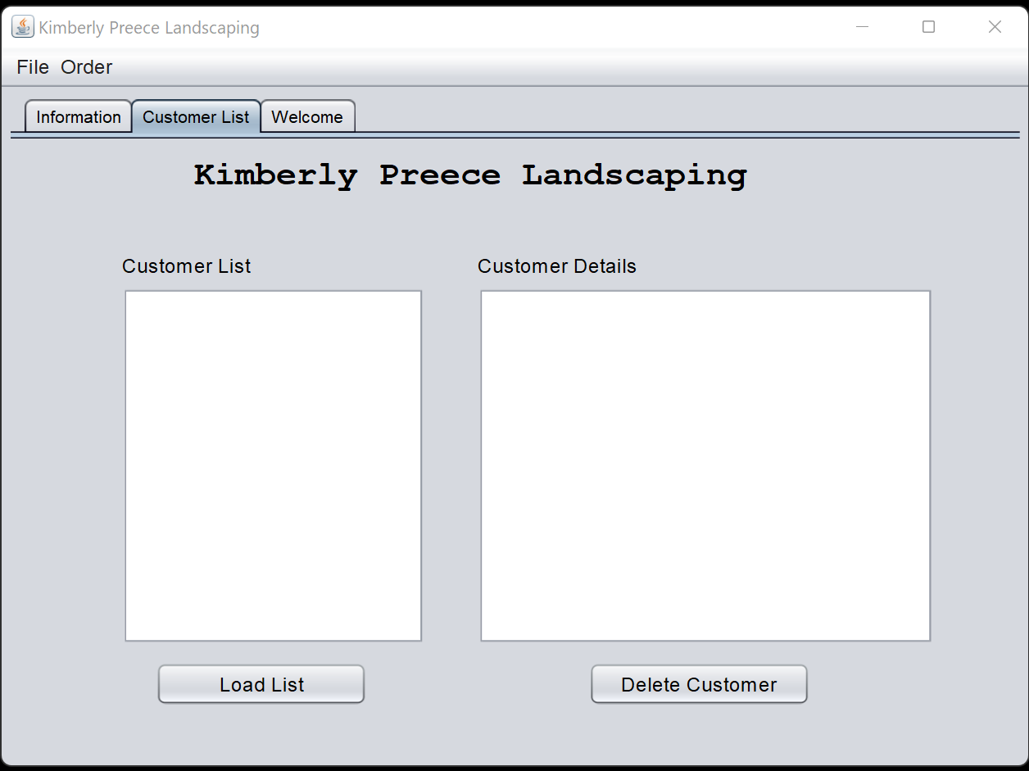
ArrayLists, Tabs, and Jlist Controls: Part I
The customer list is responsible for reading and writing the customers input into text areas for Customer List and Customer Details.
This page is also responsible for loading customer data and deleting customer data.

Slide 22
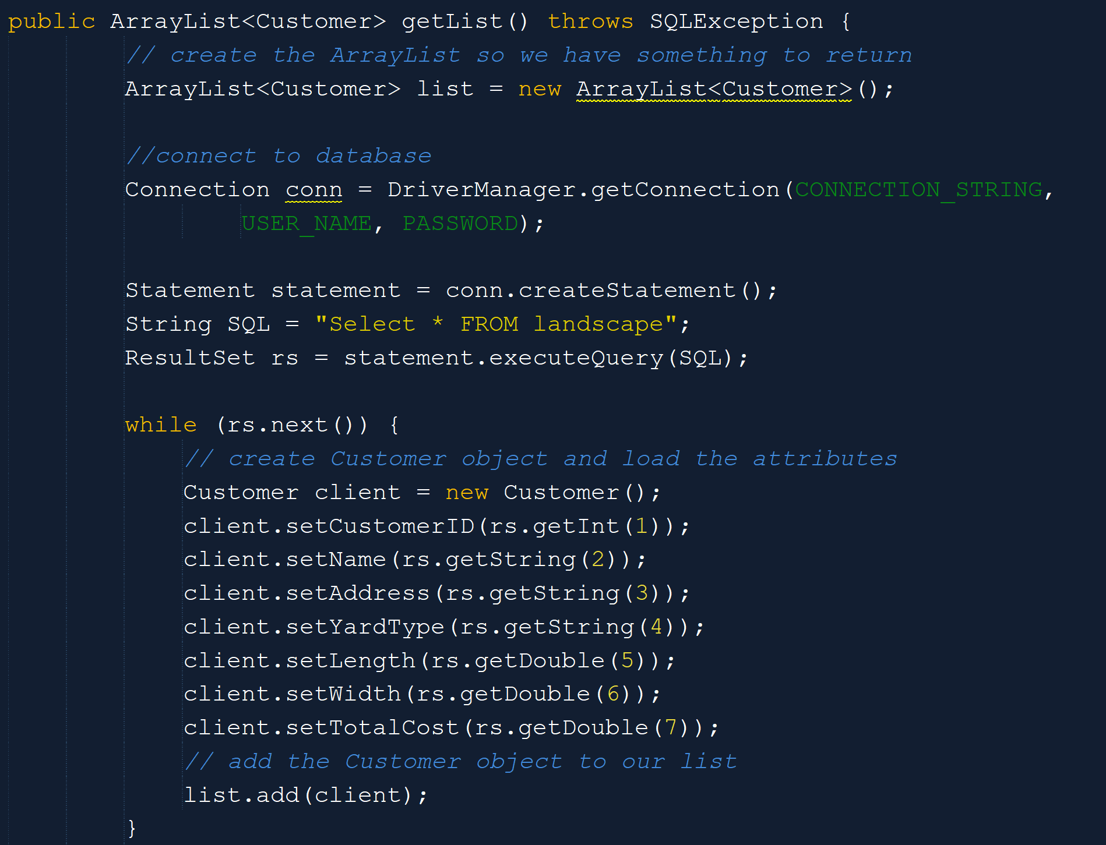
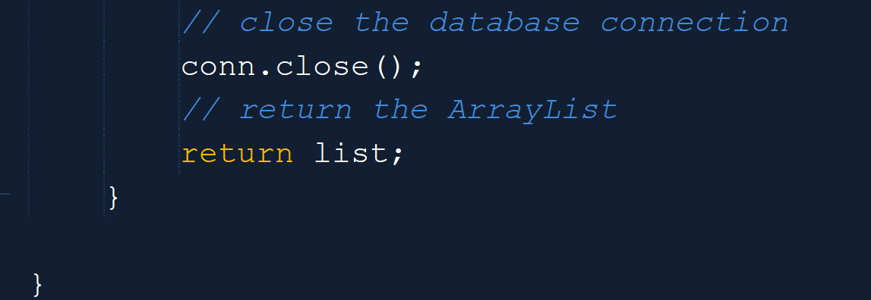
ArrayLists, Tabs, and Jlist Controls: Part II
To display the customers information, we are compiling an ArrayList that’s throws an SQLException when an error occurs. This improves the integrity and security of our data and system.
Steps taken include:
Creating the ArrayList to work with our Customer class.
Connecting to the Database (SQL) –Database comes later.
Create the customer object and load the attributes
Add the Order to the list
Close the connection – Close the connection we will add to the database.

Slide 23
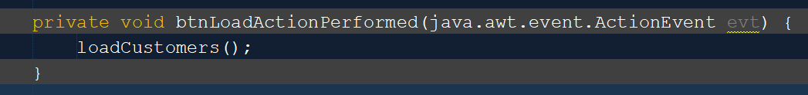
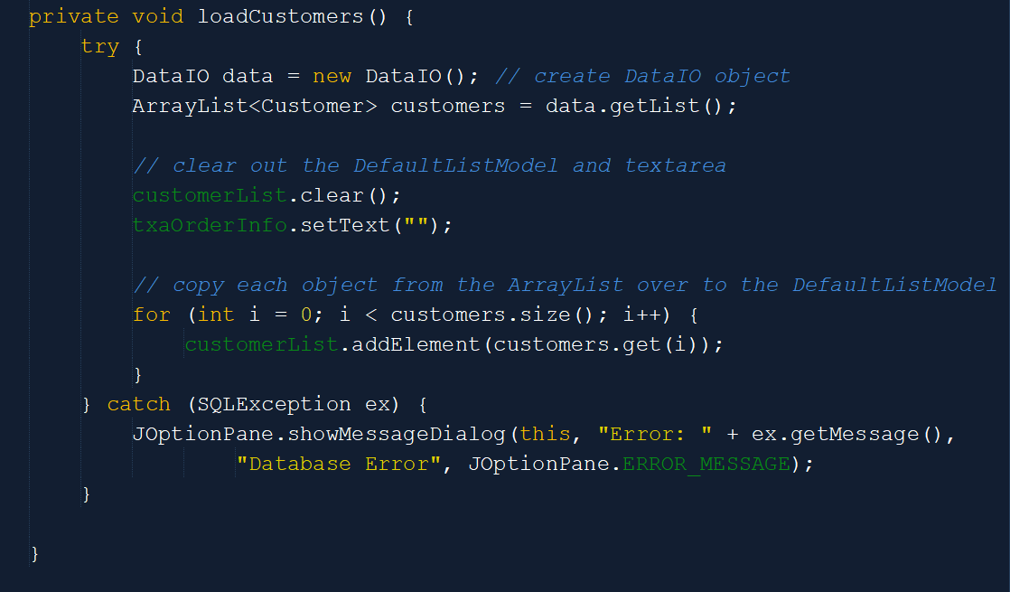
ArrayLists, Tabs, and Jlist Controls: Part III
We created a separate function that can be called whenever needed (loadCustomers).
Next, we must gather the data the customer has loaded into the text field areas.
Then, the data will be copied over to the DefaultListModel for display.
Any errors, or invalidation, will throw an exception.

Slide 24
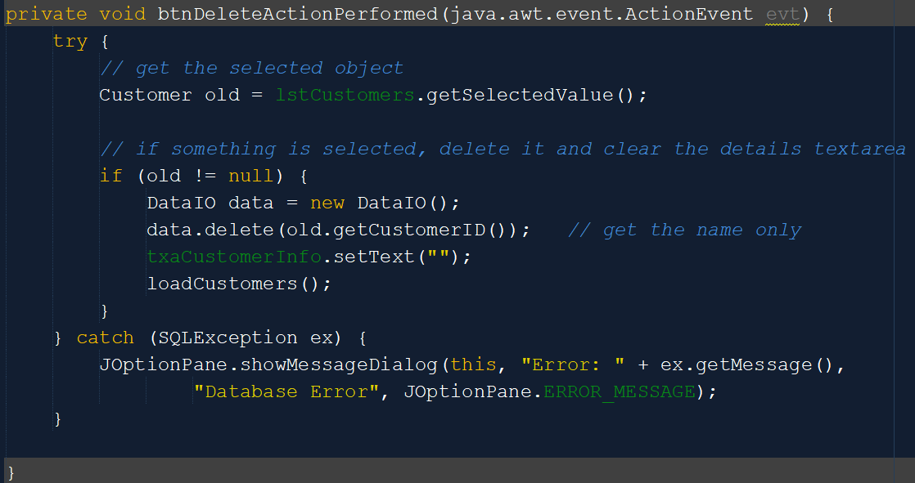
ArrayLists, Tabs, and Jlist Controls: Part IV
The “Delete Customer” button performs an ActionPerformed method to:
Gather information tied to the selection
Remove the information
Throw an exception when an error has occurred

Slide 25
Reading and Writing to Databases
We have built the framework (GUI), we have gathered the collected user input, we have created our ArrayList and Jlists
Now we need to create a database to read and write to.

Slide 26
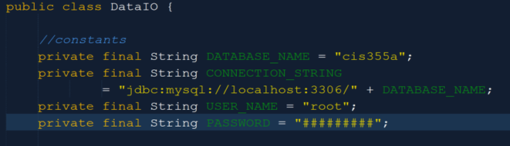
Reading and Writing to Databases: Part I
Here we have created the connection to the database by:
Defining the Database Name
Setting the Location of the Database
Providing the UserName
Providing the Password –Password has been changed for privacy.

Slide 27
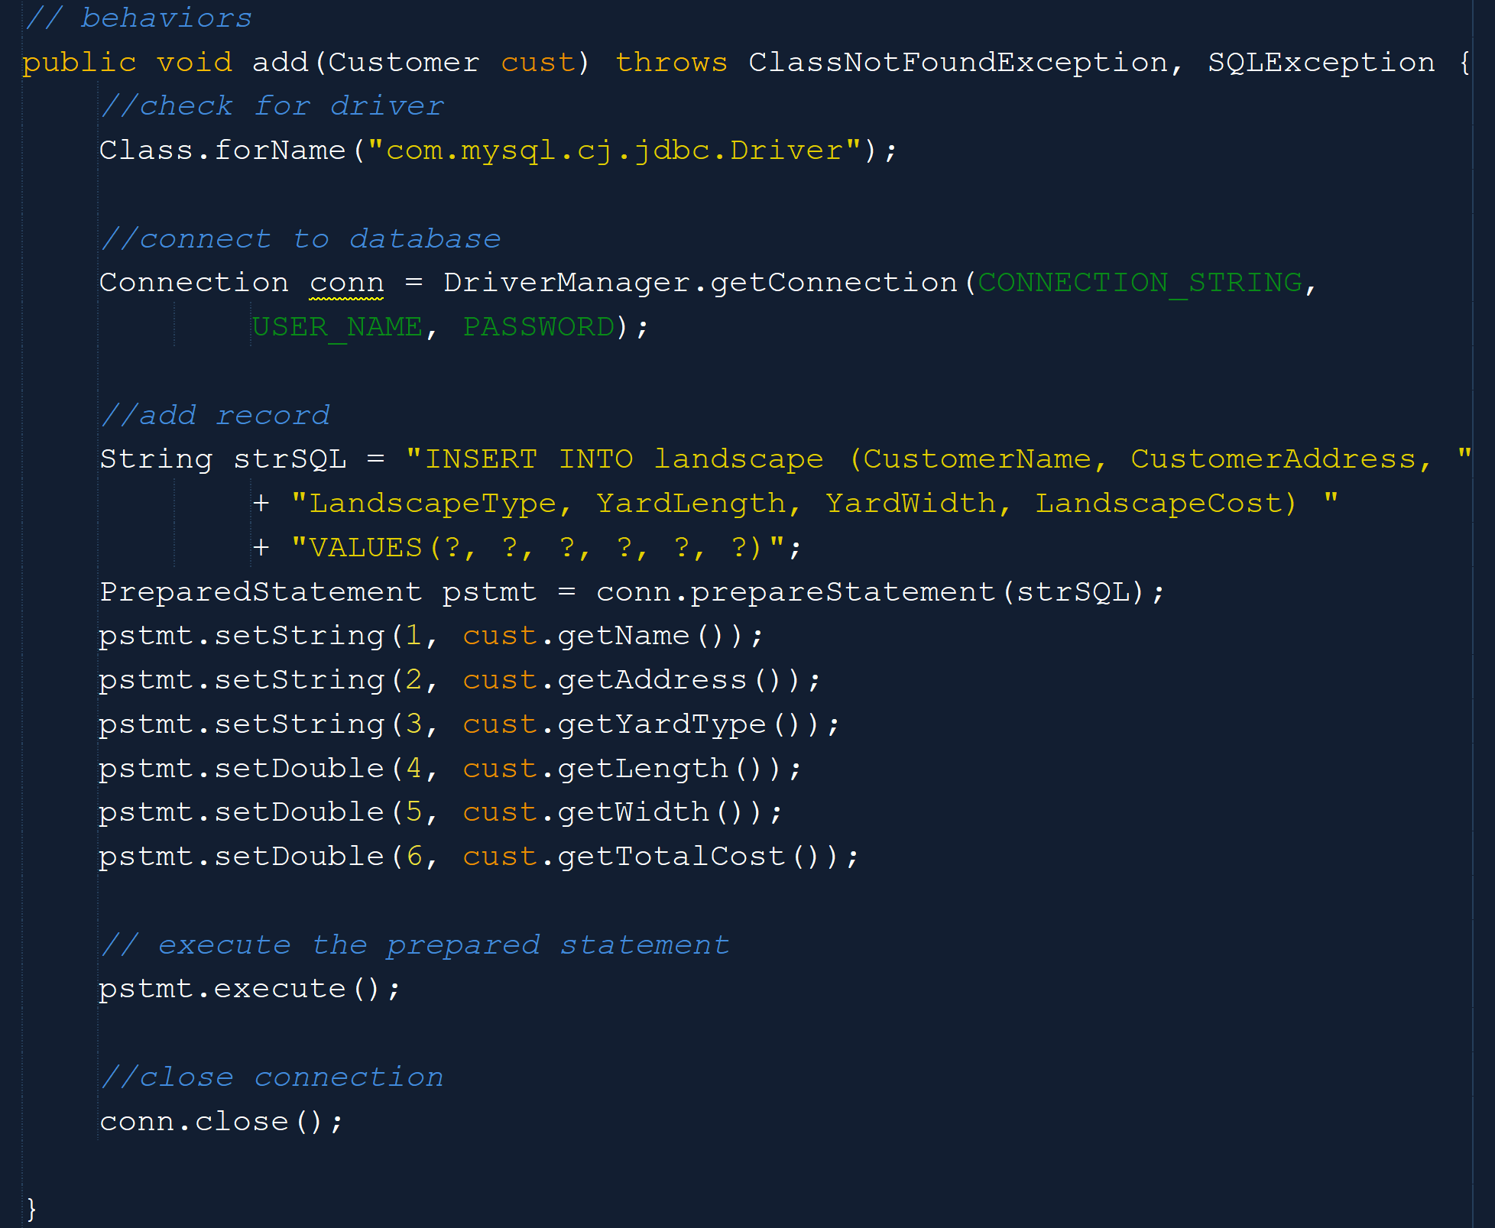
Reading and Writing to Databases: Part II
Here we will gather the information by:
Connection to the Database
Pulling data from the ArrayList
Defining the data, we wish to insert into the Database
Executing a preparedStatement
Closing the connection to the Database

Slide 28
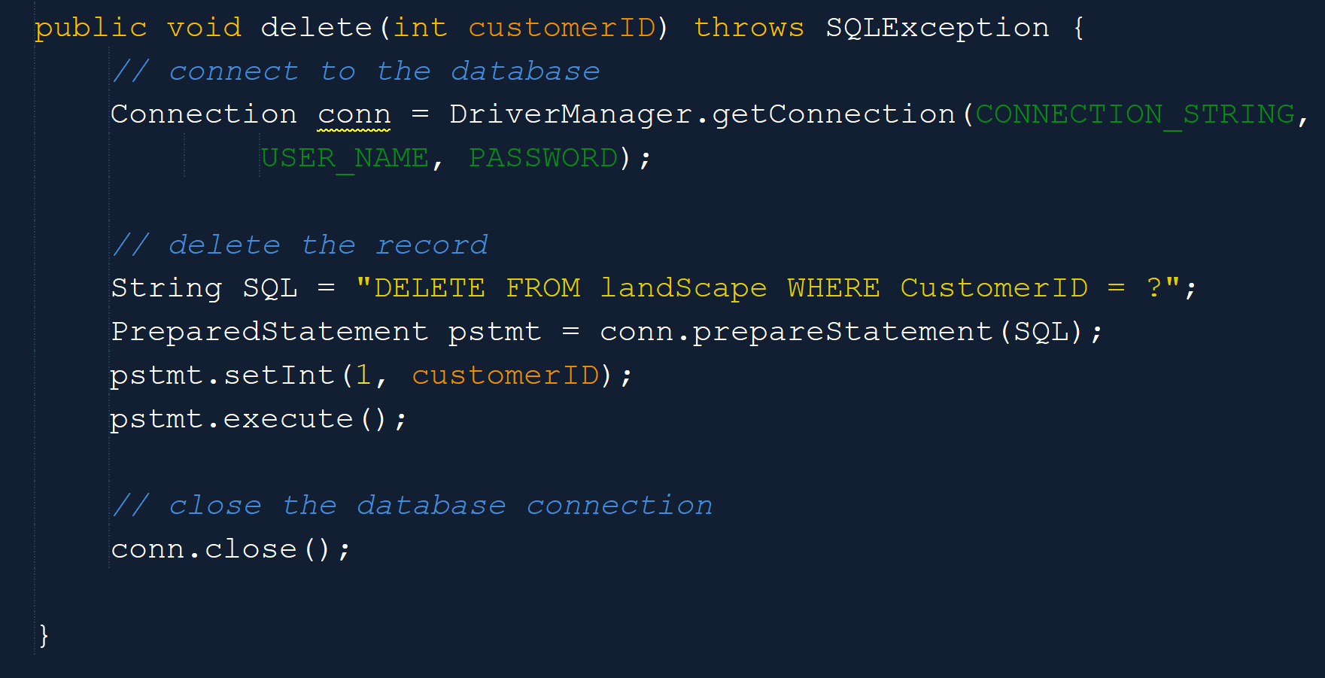
Reading and Writing to Databases: Part III
The “Delete Customer” button performs an ActionPerformed method to:
Connect to the Database
Pull the CustomerID from the database
Delete or remove the data associated with that CustomerID
Close the connection to the Database.

Slide 29
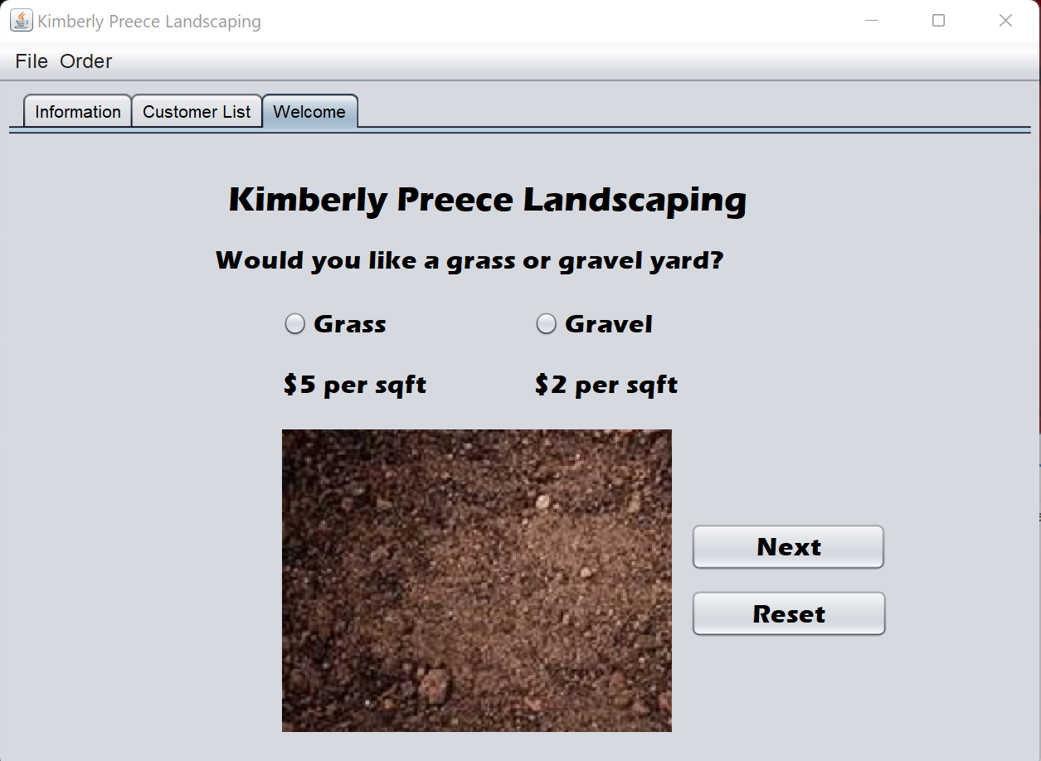
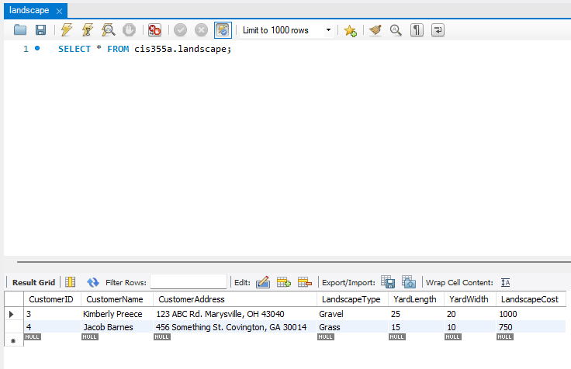
Result
We have built the program to:
Gather input from users
Output the information to users
Execute calculations for cost
Transfer the data to an SQL database table
Modify data as needed

Slide 30
Challenges
GUI
Database
The only challenges I came across when working with the GUI is keeping up with the different areas I needed to include code.
It was a challenge to differentiate between what areas needed modified when things were added or removed.
This was made slightly easier by naming components relevant to there functions.
SQL is an amazing databank system to work with.
I find it quite easy to work with as well.

Slide 31
Conclusion
GUI
Database
Building the Java GUI with Apache NetBeans was a very fun experience. With Java being on of the leading industry languages it was interesting to learn different methods and techniques to build this program.
I will be expanding to work with Java not only to build GUIs in ANT but to build in Linux, OS, Android, and Web applications.
Building, connecting, and revising databases is a skill most employees are looking for when hiring software developers, engineers, analyst, and programmers. To be able to learn and work on this skill has been truly wonderful.
I will be continuing to work with databases with Java and other languages.

Slide 32
Career Skills Obtained
Designing GUI’s in Java
Designing Classes using UML
Using three-tier development
Using Java syntax
Debugging applications
Database implantation

